Slide 1
Analog/Digital Conversions
Analog data are a function of time and occupy a limited frequency spectrum; such data can be represented by an electromagnetic signal occupying the same spectrum.
Digital data can be represented by digital signals, with a different voltage level for each of the two binary digits
But these are not the only possibilities
Digital data can also be represented by analog signals by use of a modem (modulator/demodulator)
Similarly, analog data can be represented by digital signals. The device that performs this function for voice data is a codec (coder-decoder)

Slide 2
Analog/Digital Conversions
Data stored in the computer is in the form of 0’s and 1’s. To be carried from one place to the other, data is usually converted to digital signals.
This is called “Digital-to-Digital Conversion” or “Encoding digital data into digital signals”
Sometimes we need to convert analog data to the digital signal, for example, conversion of telephone conversation to digital signal for different reasons, like to decrease effect of noise
This is called “Analog-to-Digital Conversion” or “Digitizing an Analog Signal”

Slide 3
Analog/Digital Conversions
We might want to send a digital signal coming out of computer through a medium designed for analog signals, for example, to send data from one place to the other using a telephone line.
This is called “Digital-to-Analog Conversion” or “Modulating a digital Signal”

Slide 4
Analog/Digital Conversions
Often an analog signal is sent over long distances using analog media, for example, voice or music from a radio station which is an analog signal is transmitted through the air, however the frequency of voice or music is not, suitable for this kind of transmission.
The signal should be carried by a higher frequency signal. This is called “Analog-to-Analog Conversion” or “Modulating an analog Signal”

Slide 5
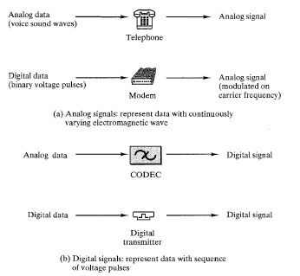
Analog/Digital Conversions

Slide 6
Types of Conversions Digital to digital Analog to digital Digital to analog Analog to analog

Slide 7
Digital-To-Digital Conversion
Representation of digital data by using digital signals
Techniques for digital-to-digital conversion
Line coding
Block coding
Scrambling

Slide 8
Digital-To-Digital Conversion
Line Coding: the process of converting digital data to digital signals
Assumption: Data is stored in computer memory as sequence of bits
Line coding converts sequence of bits to digital signals
For example when we transmit data from computer to the printer, both original and transmitted data have to be digital
Encoding a digital signal is where 1’s and 0’s generated by the computer are translated into voltage pulses that can be propagated over the wire

Slide 9
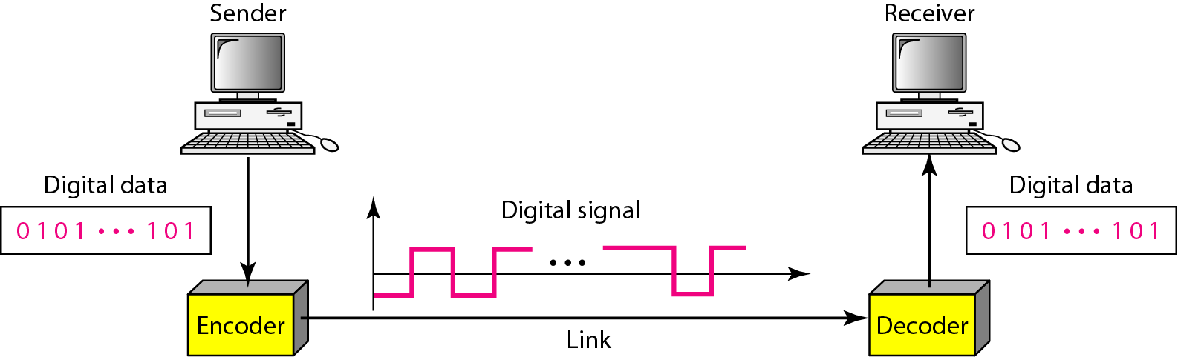
Digital-To-Digital Conversion
Line Coding
At sender: encoding of digital data into digital signal
At receiver: recreation of digital data by decoding the digital signal

Slide 10
Digital-To-Digital Conversion
Characteristics of Line Coding Schemes
Signal element versus data element
A data element is the smallest entity (bit) that can represent a piece of information
In data communications, our goal is to send data elements which are what we need to send
Data elements are being carried
A signal element is the shortest unit (time wise) of a digital signal
In digital data communications, a signal element carries data elements (carriers)
So signals elements are what we can send
Ratio of data elements to signals elements

Slide 11
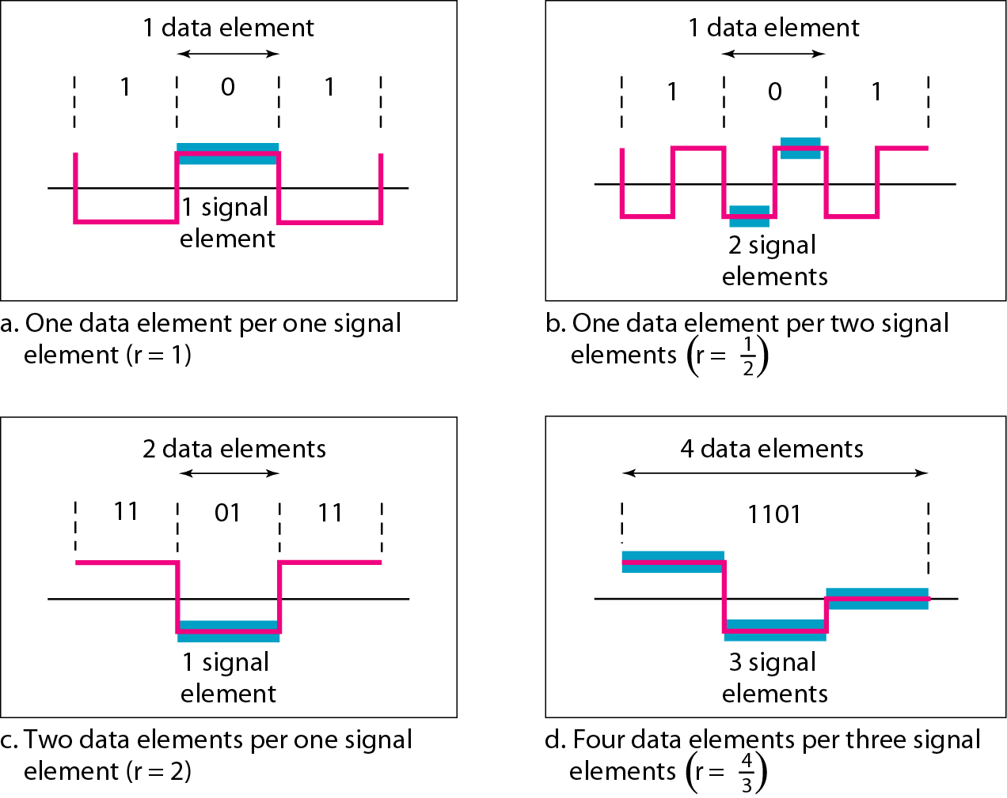
Digital-To-Digital Conversion
Characteristics of Line Coding Schemes
Signal element versus data element
In the simplest case, there is a one-to-one correspondence between bits and signal elements

Slide 12
Digital-To-Digital Conversion
Characteristics of Line Coding Schemes
Data rate versus signal rate
The data rate (bit rate) is the number of data elements (bits) sent in I second
The unit is bits per second (bps)
The signal rate (baud rate, modulation rate or pulse rate) is the number of signal elements sent in I second.
The unit is the baud
Data communications goal: increase the data rate (increasing speed of transmission) and decrease the signal rate (decreasing bandwidth requirement)

Slide 13
Digital-To-Digital Conversion
Characteristics of Line Coding Schemes
Bandwidth
Although the actual bandwidth of a digital signal is infinite, the effective bandwidth is finite
the baud rate, not the bit rate, determines the required bandwidth for a digital signal
The bandwidth reflects the range of frequencies we need

Slide 14
Digital-To-Digital Conversion
Characteristics of Line Coding Schemes
Baseline wandering
A long string of 0s or 1s can cause a drift in the baseline (baseline wandering) and make it difficult for the receiver to decode correctly
A good line coding scheme needs to prevent baseline wandering

Slide 15
Digital-To-Digital Conversion
Characteristics of Line Coding Schemes
Self synchronization
To correctly interpret the signals received from the sender,
the receiver's bit intervals must correspond exactly to the sender's bit intervals.
If the receiver clock is faster or slower
the bit intervals are not matched and the receiver might misinterpret the signals
Consider a situation where the receiver has a shorter bit duration
Let the sender sends 10110001, while the receiver receives 110111000011

Slide 16
Digital-To-Digital Conversion
Characteristics of Line Coding Schemes
Self synchronization
A self-synchronizing digital signal includes timing information in the data being transmitted
The same can be achieved by adding transitions in the signal that alert the receiver to the start, middle or end of the pulse.
These points can reset the clock in case the receiver’s clock is out of synchronization

Slide 17
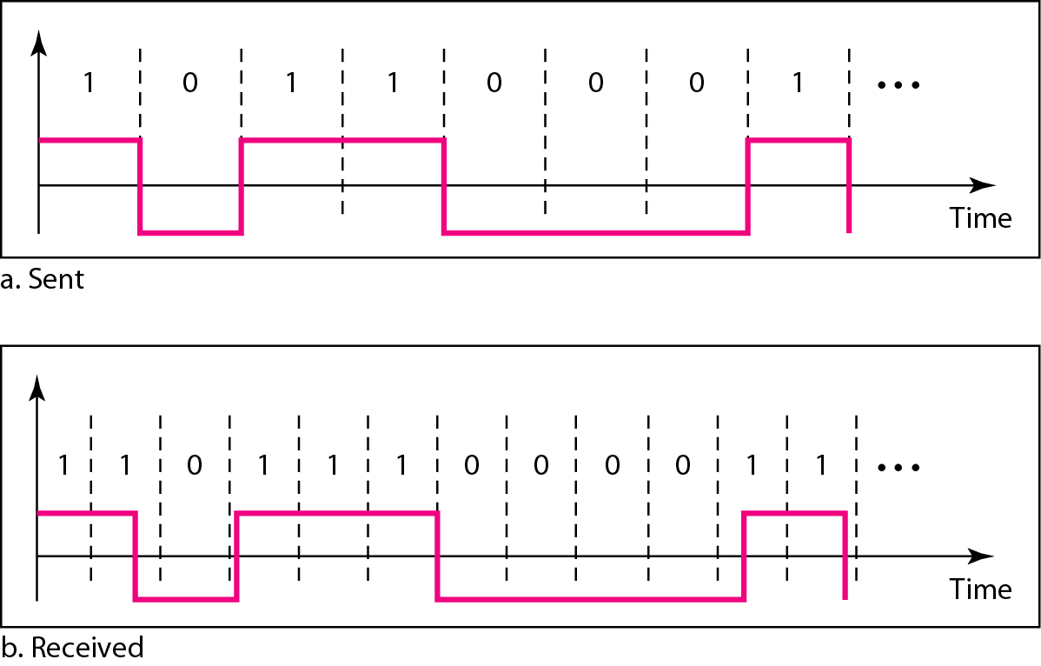
Effect of lack of synchronization
Consider a situation where the receiver has a shorter bit duration
Let the sender sends 10110001, while the receiver receives 110111000011

Slide 18
Example
In a digital transmission, the receiver clock is 0.1 percent faster than the sender clock. How many extra bits per second does the receiver receive if the data rate is 1 kbps?
How many if the data rate is 1 Mbps?
Solution
At 1 kbps, the receiver receives 1001 bps instead of 1000 bps.
At 1 Mbps, the receiver receives 1,001,000 bps instead of 1,000,000 bps.

Slide 19
Digital-To-Digital Conversion
Characteristics of Line Coding Schemes
Built-in error detection
Desirable to have a built-in error-detecting capability in the generated code to detect some of or all the errors that occurred during transmission
Immunity to noise and interference
Desirable to have a code that is immune to noise and other interferences
Complexity
A complex scheme is more costly to implement than a simple one
Example: a scheme that uses four signal levels is more difficult to interpret than one that uses only two levels

Slide 20
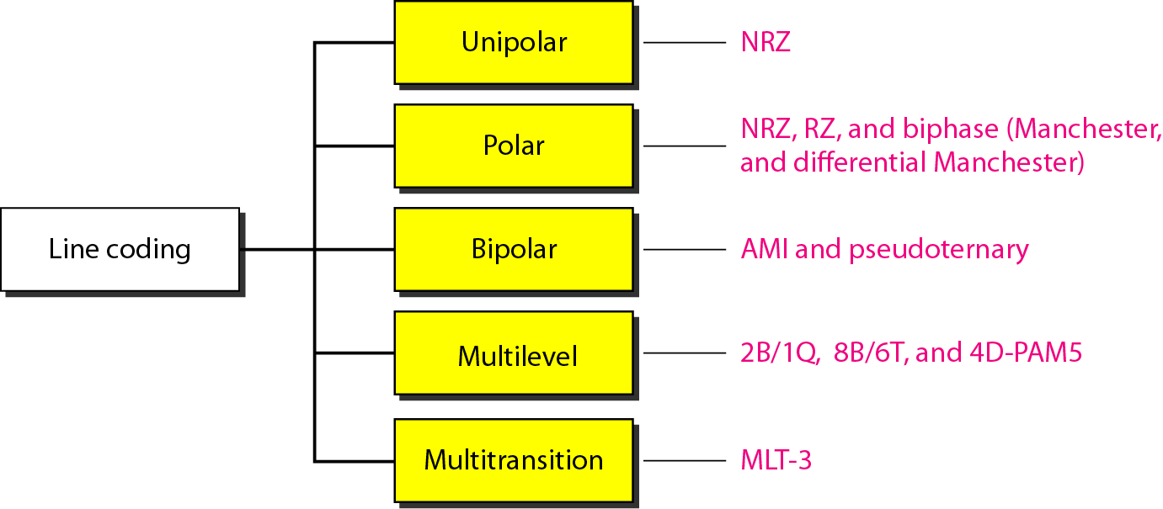
Digital-To-Digital Conversion
Line Coding Schemes (types of encoding)

Slide 21
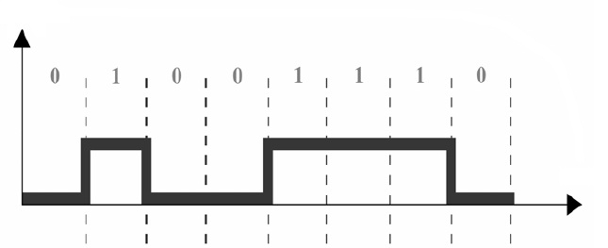
Line Coding Schemes: Unipolar
Unipolar: non-return-to-zero (NRZ) [no return in middle]
Encoding is simple , with only one technique in use
all the signal levels are on one side of the time axis, either above or below
It is called Unipolar because it uses only one polarity
positive voltage defines bit 1 and the zero voltage defines bit 0

Slide 22
Practice Example
Convert the following data elements (bit stream) into digital signals using Unipolar Scheme
11001101

Slide 23
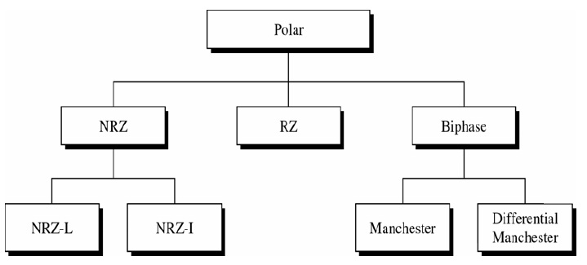
Line Coding Schemes: Polar
Polar
Polar encoding uses two voltage levels, positive and negative (on both sides of time axis)
The voltage level for 0 bit can be positive (+ve) and the voltage level for 1 can be negative
3 subcategories: NRZ, RZ, Biphase

Slide 24
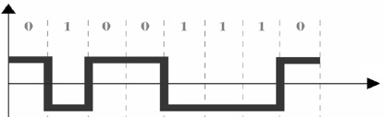
Line Coding Schemes: Polar
Polar: NRZ
Non-return-to-zero-level (NRZ-L)
A +ve voltage means the bit is a 0 and a –ve voltage means the bit is a 1 (vice versa may also be true)

Slide 25
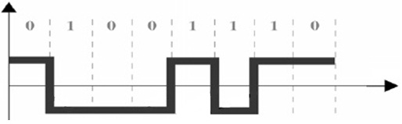
Line Coding Schemes: Polar
Polar: NRZ : Non-return-to-zero-Invert (NRZ-I)
the change or lack of change in the level of the voltage determines the value of the bit
If there is no change, the bit is 0;
if there is a change, the bit is 1
A transition (low-to-high or high-to-low) at the beginning of a bit time denotes a binary 1 for that bit time; no transition indicates a binary 0

Slide 26
Practice Example
Convert the following data elements (bit stream) into digital signals using NRZ-I Scheme
10101100

Slide 27
NRZ-L and NRZ-I both have a DC component problem and baseline wandering, it is worse for NRZ-L. Both have no self synchronization &no error detection. Both are relatively simple to implement.

Slide 28
Line Coding Schemes: Polar
Polar: Return-to-zero (RZ)
Any time, data contains long strings of 1’s or 0’s, receiver can loose its timing (synchronization problem of NRZ)
One solution is RZ encoding which uses 3 values; Positive, Negative and Zero
Signal changes not between bits but during each bit

Slide 29
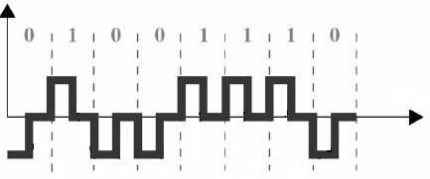
Line Coding Schemes
Here, +ve voltage means 1 and a –ve voltage means 0,
but unlike NRZ-L, half way through each bit interval, the signal returns to zero
A 1 bit is represented by positive to zero and a 0 is represented by negative to zero transition

Slide 30
Practice Example
Convert the following data elements (bit stream) into digital signals using Polar RZ Scheme
10101100

Slide 31
Line Coding Schemes
Problem with RZ
Main problem with RZ encoding is that it requires two signal changes to encode one bit
therefore occupies more bandwidth
But it is most effective solution so that receiver cannot lose timing (no DC component problem)
Complexity: uses three levels of voltage

Slide 32
Line Coding Schemes: Polar
Biphase
Best existing solution to the problem of synchronization
Signal changes at the middle of bit interval but does not stop at zero
Instead it continues to the opposite pole
There are two types of biphase encoding
Manchester
Differential Manchester

Slide 33
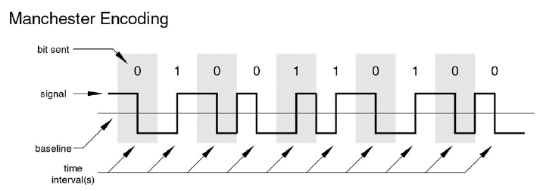
Line Coding Schemes: Polar
Biphase: Manchester
Transition in middle of each bit period
Transition serves as clock and data
Used by IEEE 802.3 (10Mbps Ethernet)
Negative-to-Positive Transition (low to high) = 1
Positive-to-Negative Transition (high to low) = 0

Slide 34
Practice Example
Convert the following data elements (bit stream) into digital signals using Biphase Manchester encoding Scheme
10101100

Slide 35
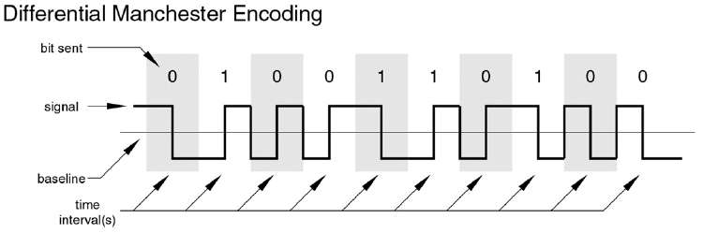
Line Coding Schemes: Polar
Biphase: Differential Manchester
Midbit transition is clocking only (for synchronization)
• Transition at start of a bit period represents zero
• No transition at start of a bit period represents one
• Note: this is a differential encoding scheme
• Used by IEEE 802.5 (Token ring)

Slide 36
Line Coding Schemes: Polar

Slide 37
Practice Example
Convert the following data elements (bit stream) into digital signals using Biphase Differential Manchester encoding Scheme
10101100

Slide 38
Line Coding Schemes: Bipolar
Bipolar encoding
There are three voltage levels; +ve, -ve, zero to represent the symbols (note not transitions to zero as in RZ)
Voltage level for one symbol is at “0” and the other alternates between +ve & -ve.
Bipolar Alternate Mark Inversion (AMI): the “0” symbol is represented by zero voltage and the “1” symbol alternates between +V and -V.
Pseudoternary is the reverse of AMI: the “1” symbol is represented by zero voltage and the “0” symbol alternates between +V and -V

Slide 39
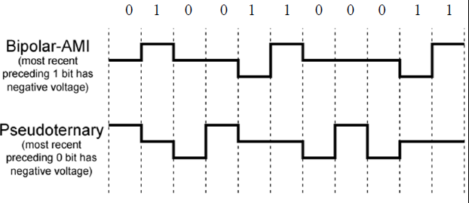
Line Coding Schemes: Bipolar
Bipolar encoding
Bipolar Alternate Mark Inversion (AMI) and Pseudoternary

Slide 40
Practice Example
Convert the following data elements (bit stream) into digital signals using AMI and Pseudoternary Scheme
10101100

Slide 41
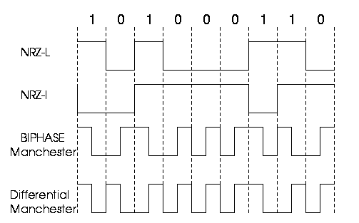

Slide 42
Alternate Mark Inversion(AMI)
Pros and Cons:
There will be no loss of synchronization if a long string of 1s occurs
Each 1 introduces a transition, and the receiver can resynchronize on that transition
A long string of 0s would still be a problem
No error detection

